Slide 1
Parameter Estimation
25 June 2020
for Invasive Aspergillosis in silico Model
Name: Jiujia Zhang
CID: 01203777

Slide 2
Outline
Background
Project Aim
Methodology
Results and Discussion
Conclusion and Future Direction

Slide 3
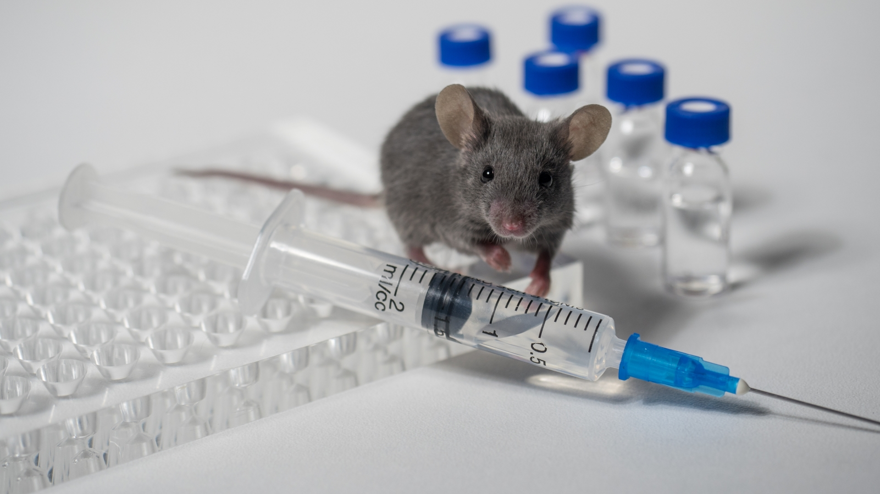
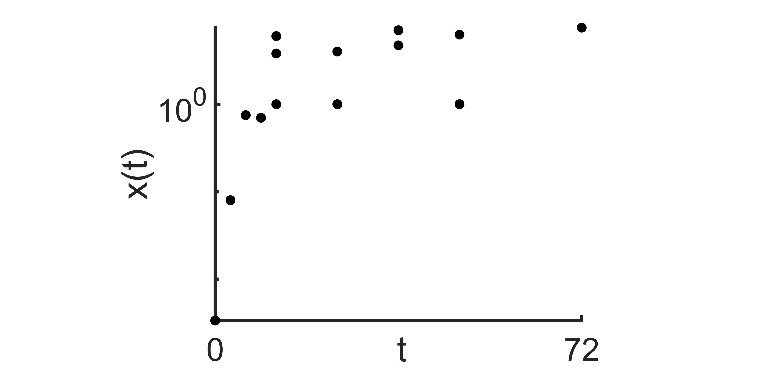

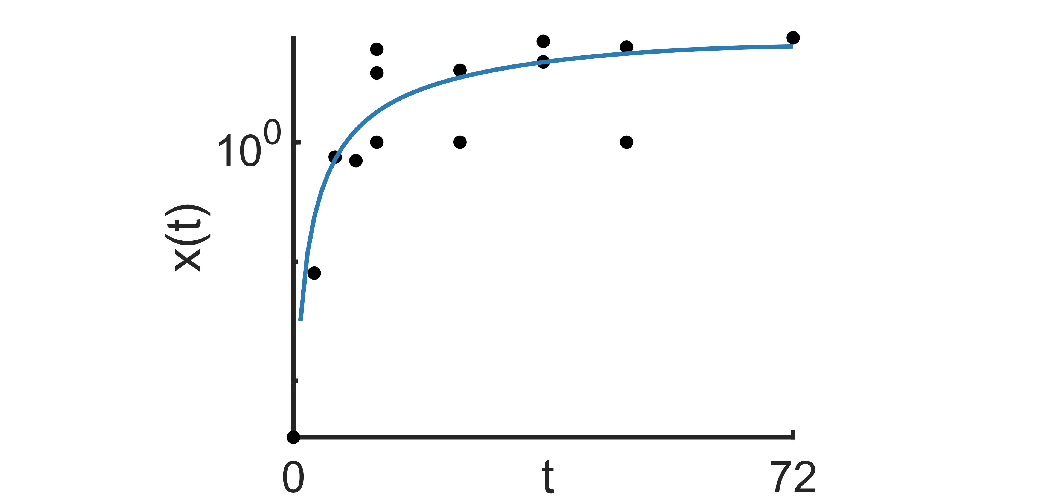
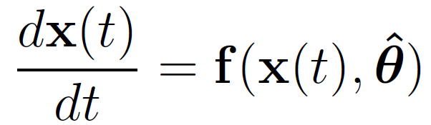
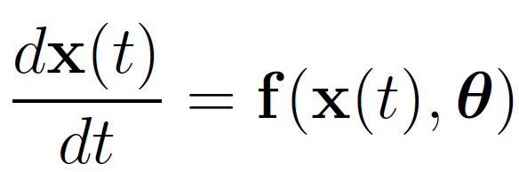
Parameter Estimation:
Background
Experiment
Experimental Data
Parameter Estimation
Fitted Model
Mathematical Model
1/11

Slide 4
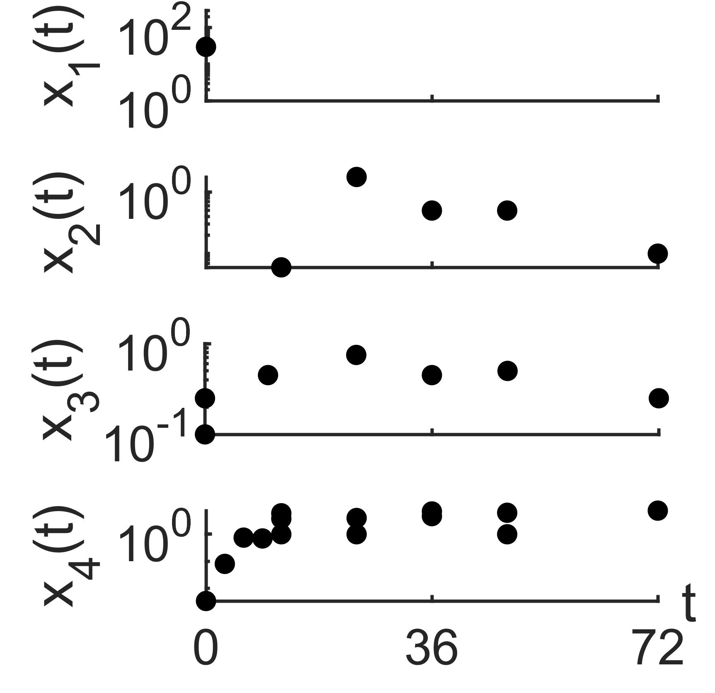
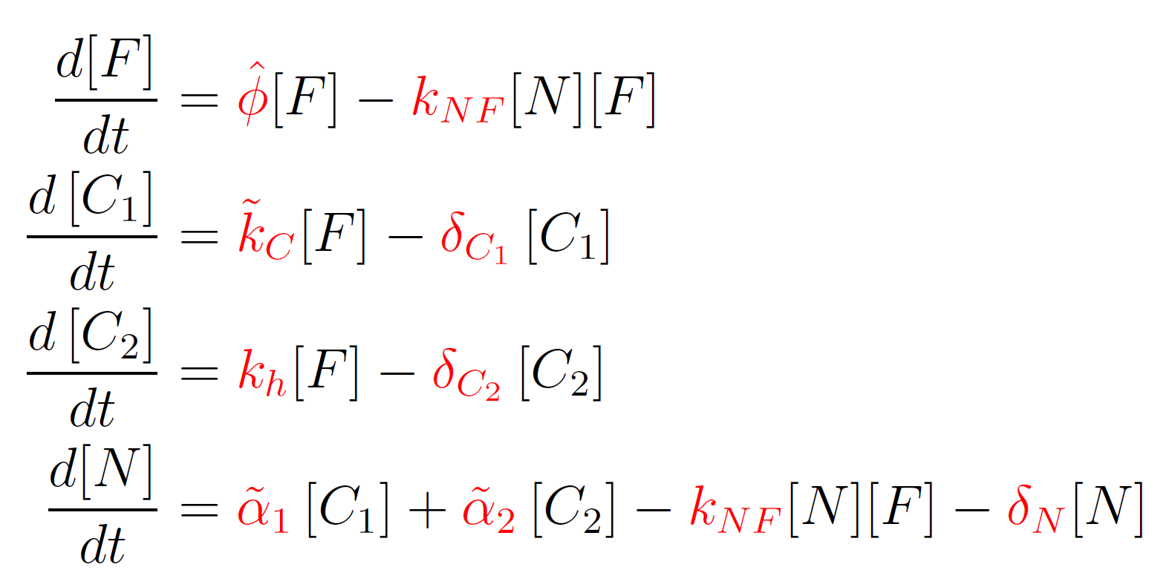
Challenges in Immunology:
Background
Experimental Data:
Invasive Aspergillosis Model:
Sparsity
2/11

Slide 5
Challenges in Immunology:
Background
Experimental Data:
Invasive Aspergillosis Model:
Sparsity
Latency
2/11

Slide 6
Challenges in Immunology:
Background
Experimental Data:
Invasive Aspergillosis Model:
Sparsity
Latency
Non-simultaneous Measurements
2/11

Slide 7
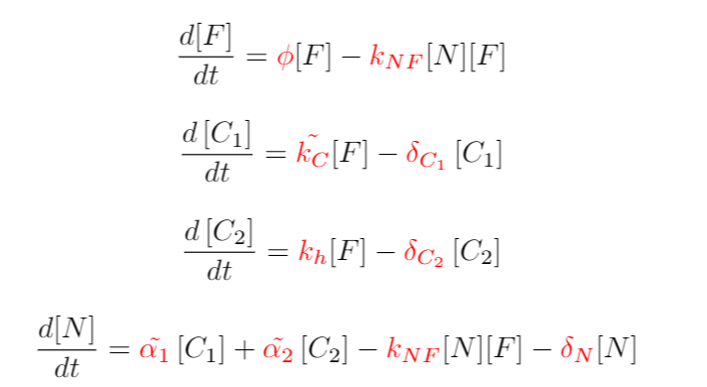
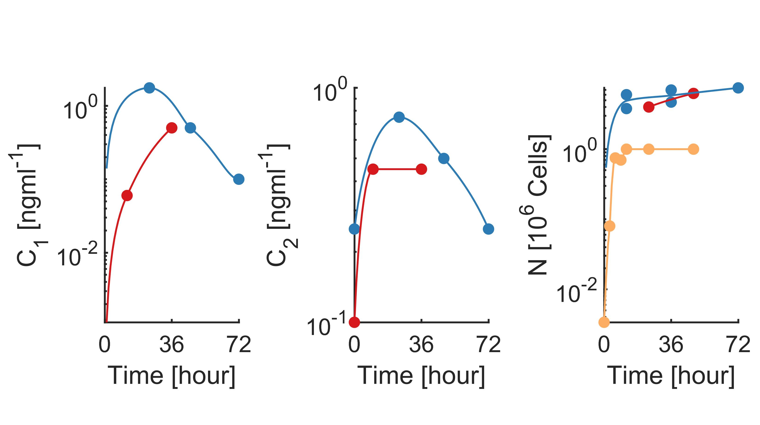
Parameter Estimation with Sparse data
Project Aim
Can parameters be possibly estimated using sparse data?
Parameter values?
[Kasahara et al.2016a]
[Jhingran et al.2012a]
[Kasahara et al.2016b]
[Jhingran et al.2015]
[Kasahara et al.2016c]
[Rosowski et al.2018]
[Jhingran et al.2012b]
3/11

Slide 8
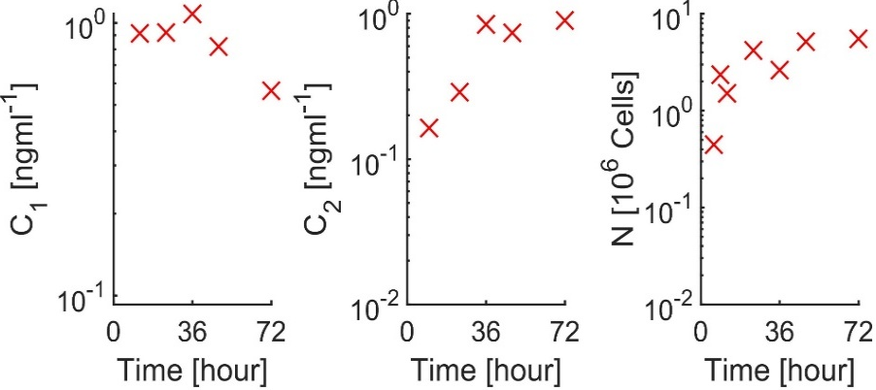
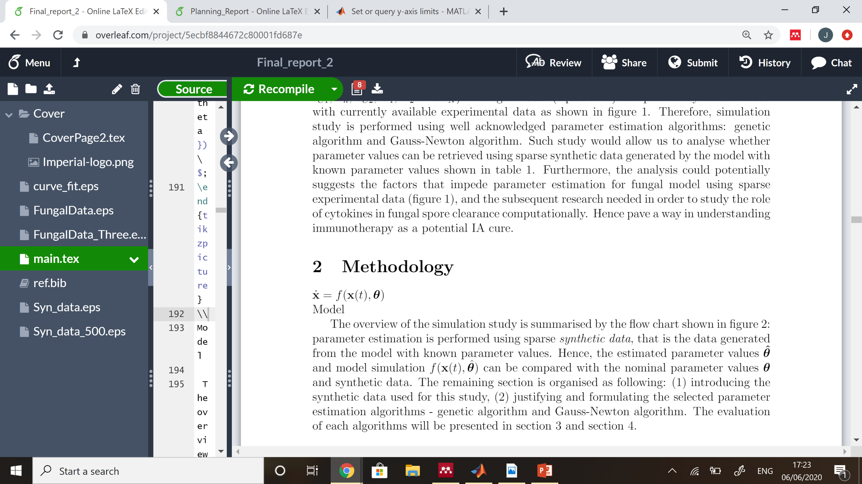
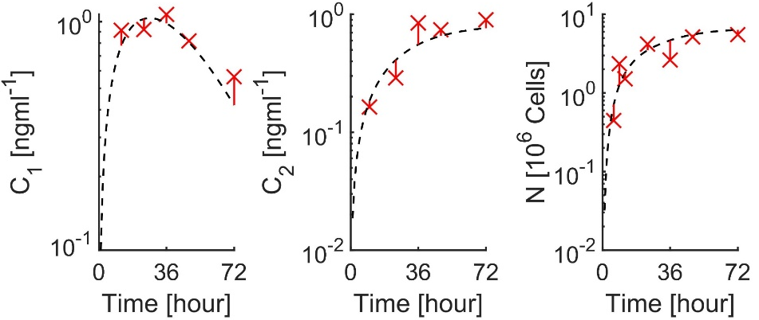
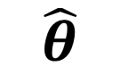
Methodology:
Methodology
Synthetic data
Estimated Parameter
Parameter Estimation
$$\hat{θ}$$
4/11

Slide 9
Methodology:
Methodology
Synthetic data
Estimated Parameter
Parameter Estimation
$$\hat{θ}$$
4/11

Slide 10
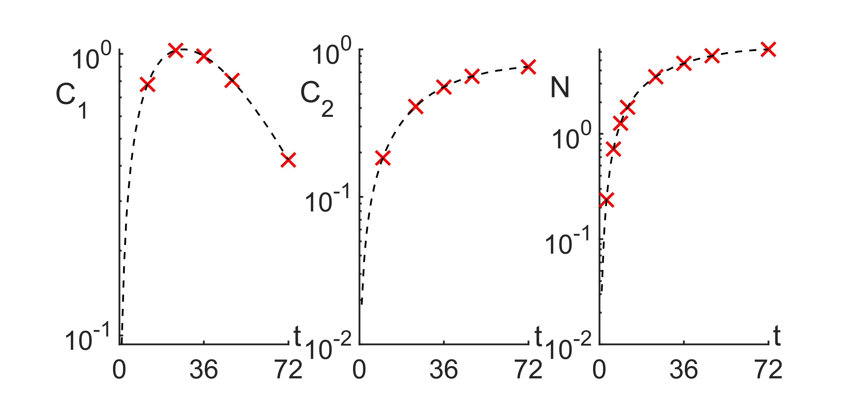
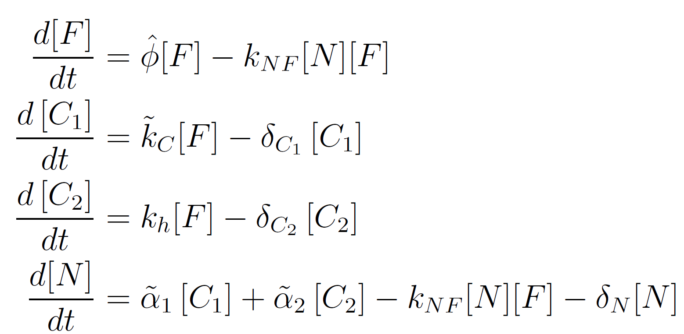
Synthetic Data:
Methodology
Sparsity
Latency
Non-simultaneous Measurements
5/11

Slide 11
Methodology:
Methodology
Synthetic data
Estimated Parameter
Parameter Estimation
$$\hat{θ}$$
6/11

Slide 12

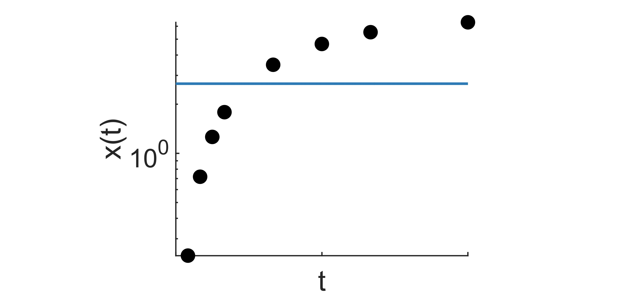
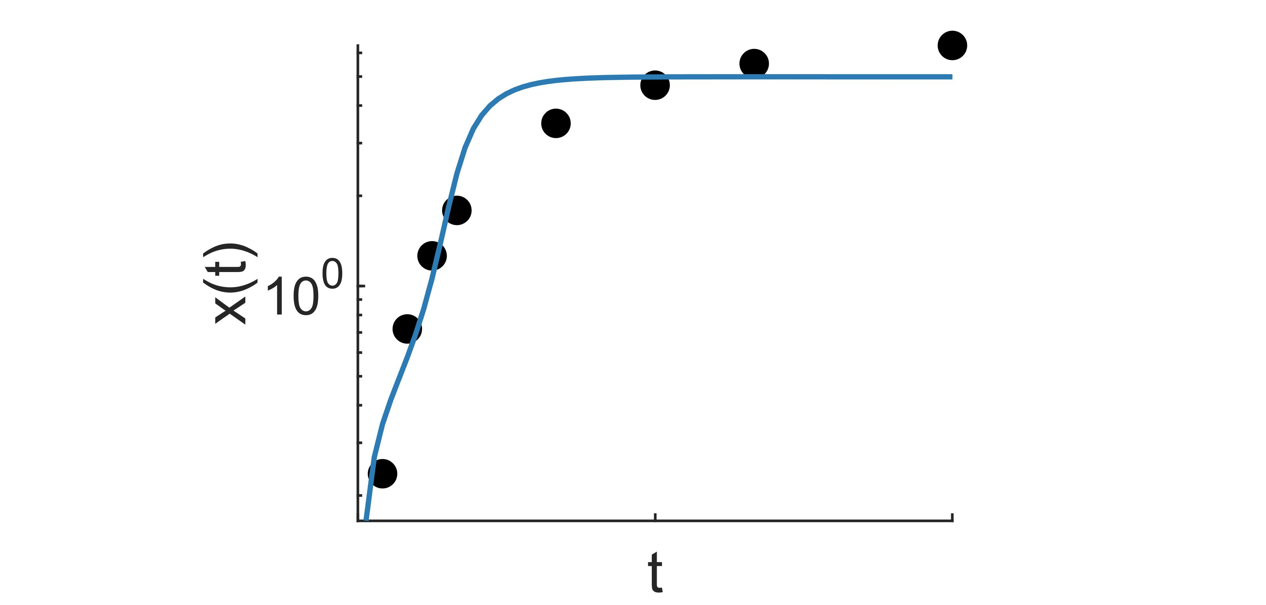
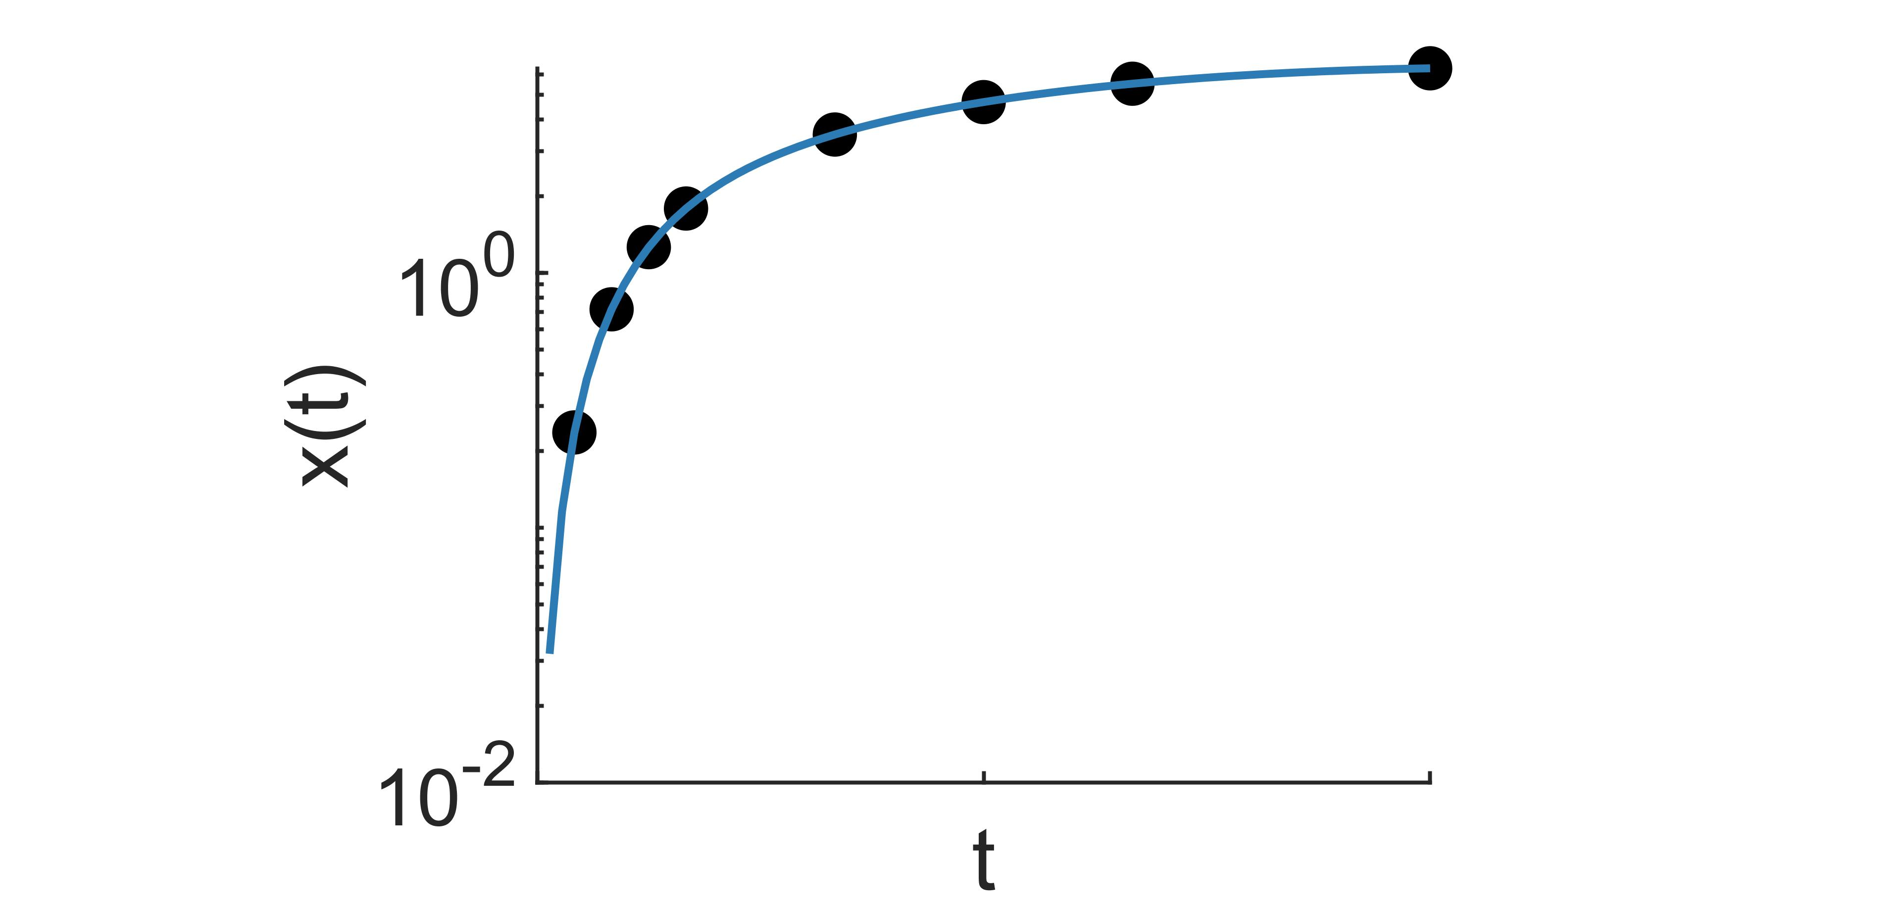
Genetic Algorithm:
Methodology
Darwinian evolutionary theory: Survival of the fittest
Biological System:
Parameter Estimation:
7/11

Slide 13
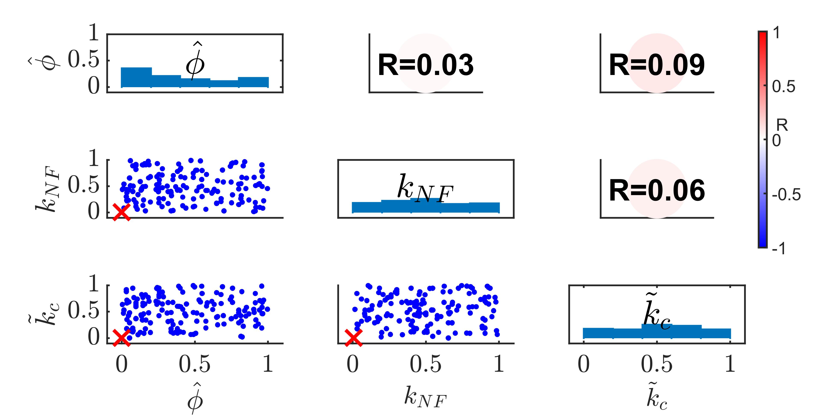
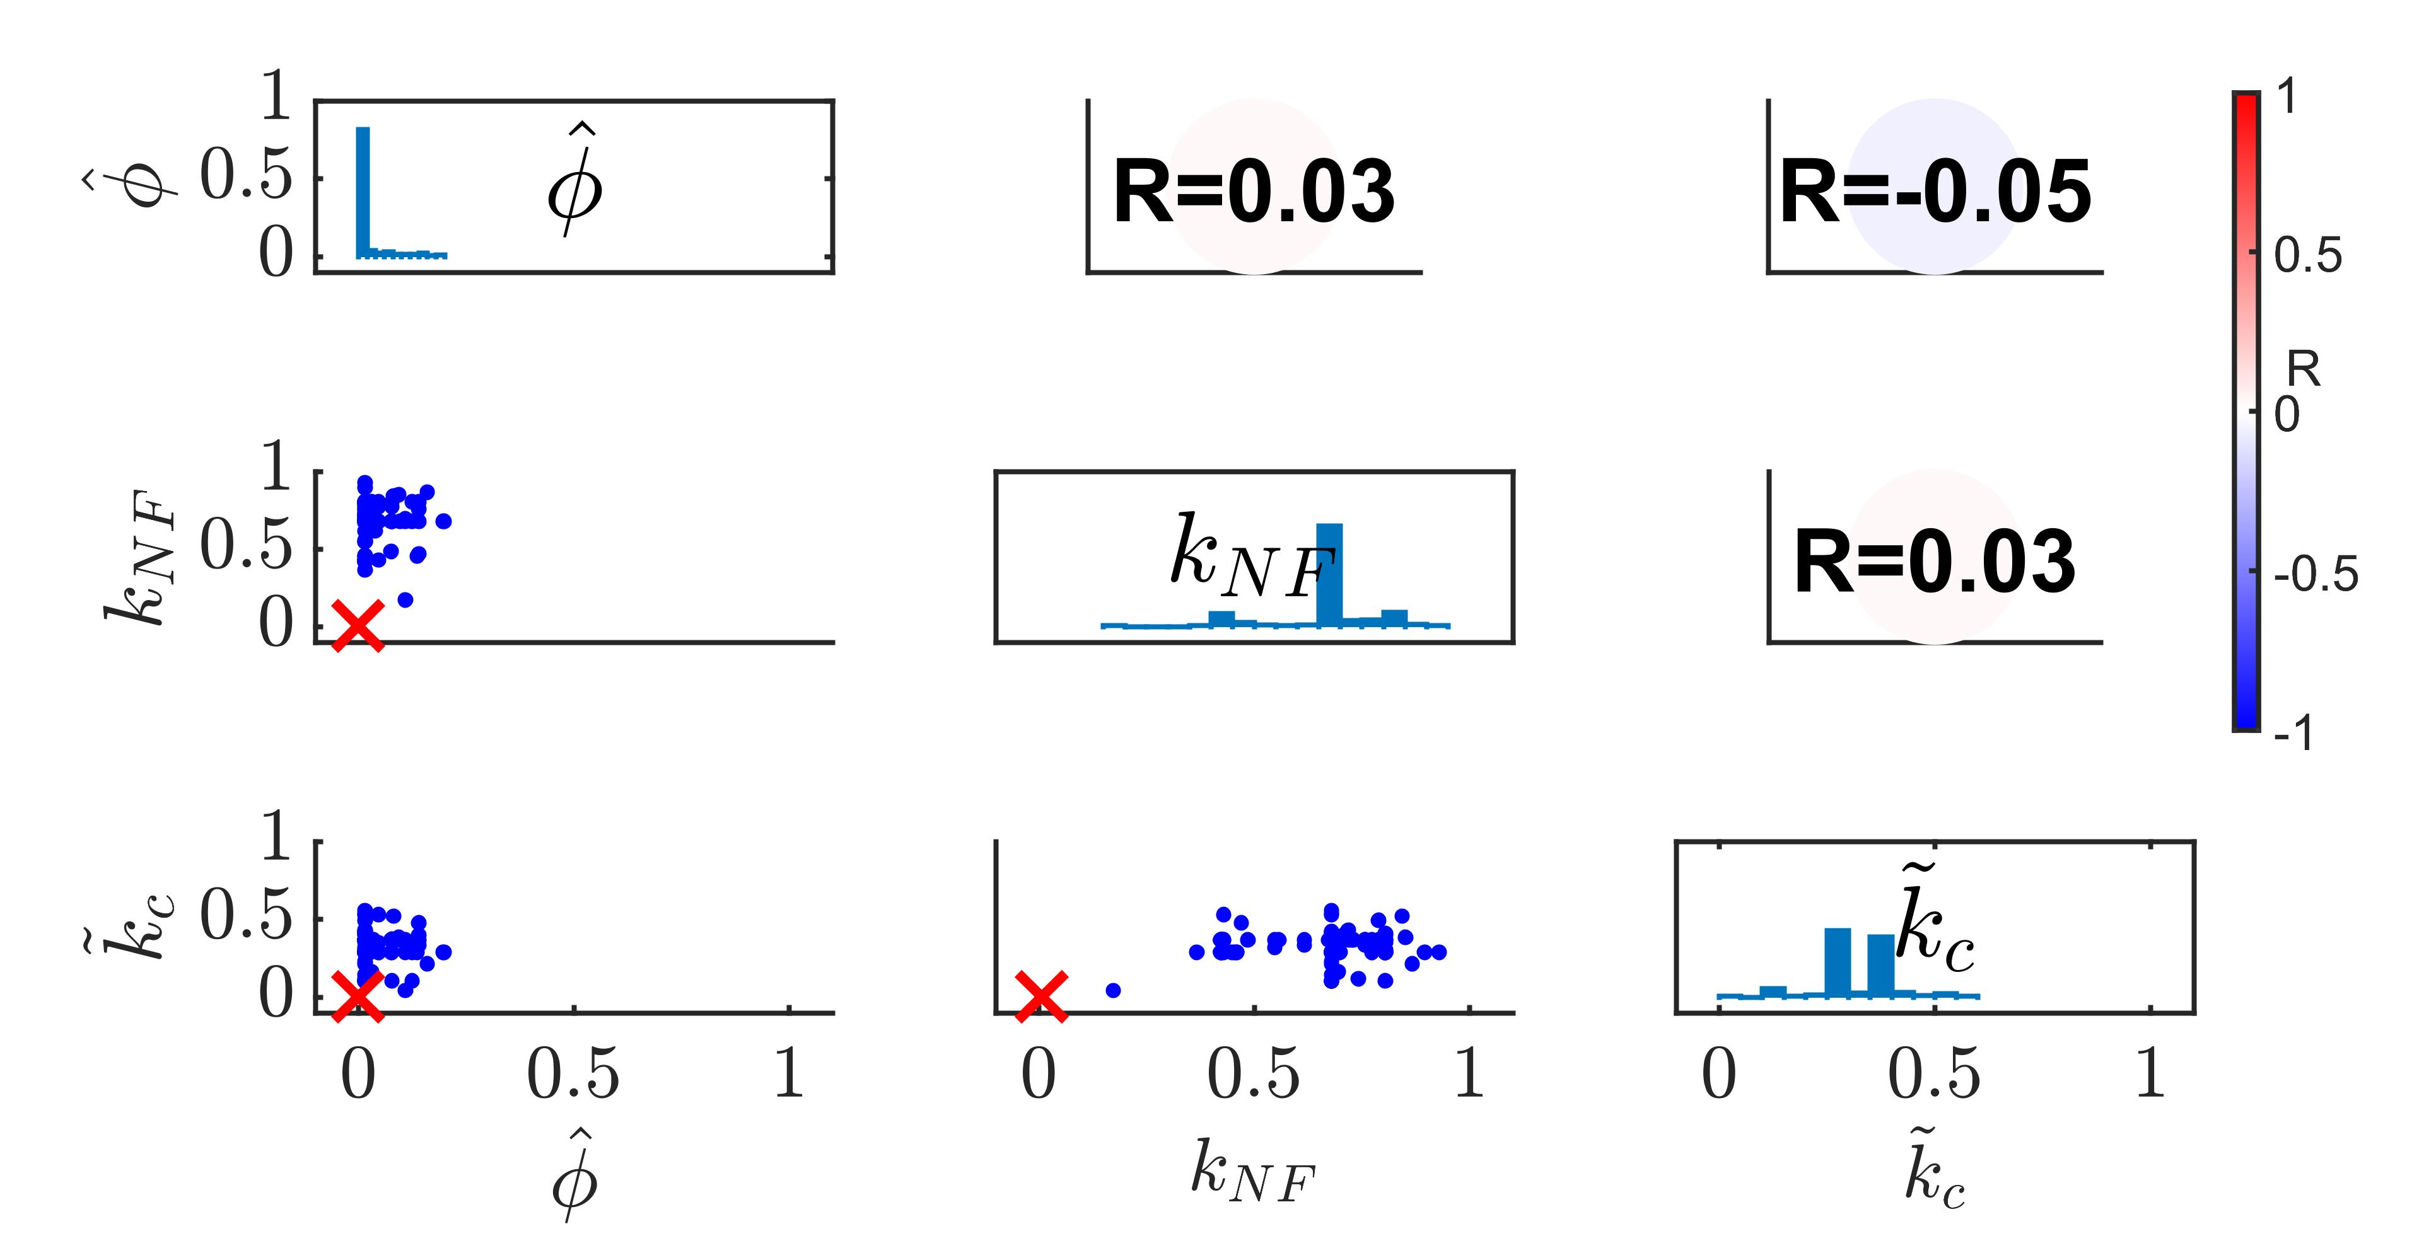
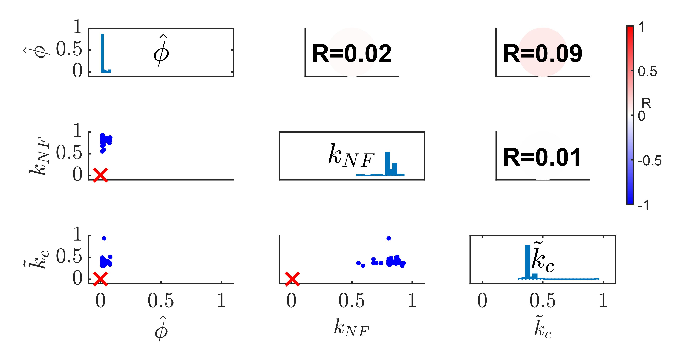
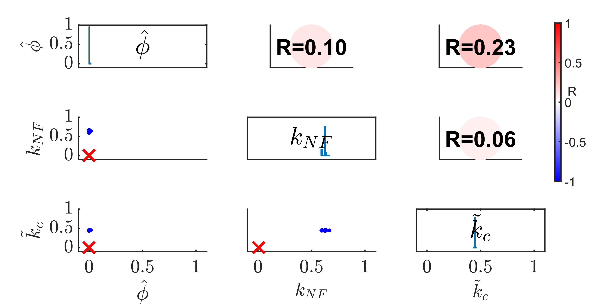
Parameter Retrieval:
Results and Discussion
(a)
(b)
(c)
(d)
8/11

Slide 14
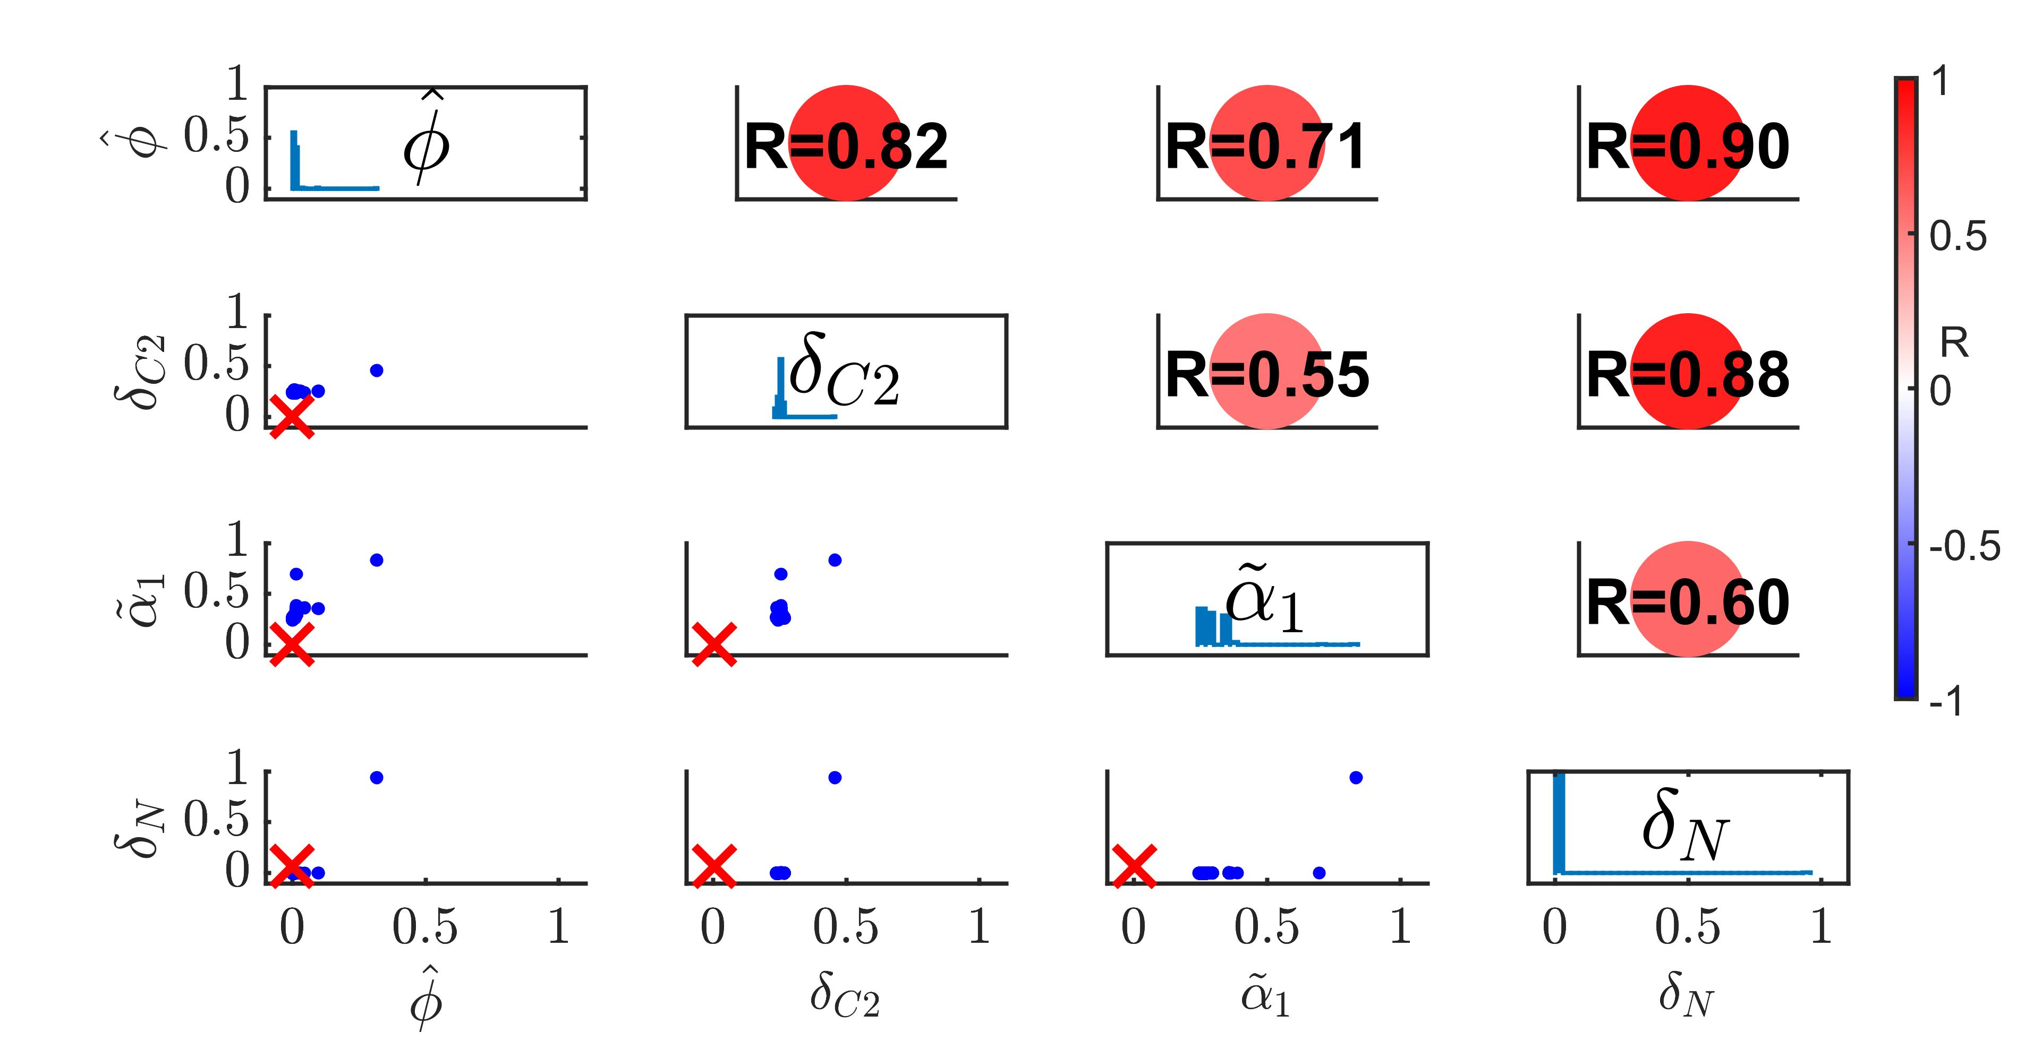
Parameter Identifiability:
Results and Discussion
Parameters resultant in considerably similar model simulation trajectories:
Non-unique
Highly Correlated
9/11

Slide 15
Conclusion
Conclusion and Future Direction
Parameters cannot be retrieved
Parameter estimation for the testing model is unlikely to be achieved
Existence of non-identifiable parameters
Attributed to model structure or data sparsity
Data sparsity is not the only factor that complicated parameter estimation problems
10/11

Slide 16
Future Direction
Conclusion and Future Direction
Identifiability Tests:
Experimental Data
Data
Sparsity
Parameter Estimation
Fitted Model
Parameter Identifiability
Mathematical Model
11/11

Slide 17
Reference
[Jhingran et al.2015] Jhingran, A., Kasahara, S., Shepardson, K. M., Junecko, B. A. F., Heung, L. J.,
Kumasaka, D. K., Knoblaugh, S. E., Lin, X., Kazmierczak, B. I., Reinhart, T. A., Cramer, R. A., and
Hohl, T. M. (2015). Compartment-specic and sequential role of myd88 and card9 in chemokine induction
and innate defense during respiratory fungal infection. PLOS Pathogens, 11(1):1{22.
[Jhingran et al.2012a] Jhingran, A., Mar, K., Kumasaka, D., Knoblaugh, S., Ngo, L., Segal, B., Iwakura,
Y., Lowell, C., Hamerman, J., Lin, X., and Hohl, T. (2012a). Tracing conidial fate and measuring host
cell antifungal activity using a reporter of microbial viability in the lung. Cell Reports, 2(6):1762 { 1773.
[Jhingran et al.2012b] Jhingran, A., Mar, K., Kumasaka, D., Knoblaugh, S., Ngo, L., Segal, B., Iwakura,
Y., Lowell, C., Hamerman, J., Lin, X., and Hohl, T. (2012b). Tracing conidial fate and measuring host
cell antifungal activity using a reporter of microbial viability in the lung. Cell reports, 2.
[Kasahara et al.2016a] Kasahara, S., Jhingran, A., Dhingra, S., Salem, A., Cramer, R., and Hohl, T. (2016a).
Gm-csf signaling regulates neutrophil antifungal activity and the oxidative burst during respiratory fungal
challenge. Journal of Infectious Diseases, 213:jiw054.

Slide 18
Reference
[Kasahara et al.2016b] Kasahara, S., Jhingran, A., Dhingra, S., Salem, A., Cramer, R. A., and Hohl, T. M.
(2016b). Role of Granulocyte-Macrophage Colony-Stimulating Factor Signaling in Regulating Neutrophil
Antifungal Activity and the Oxidative Burst During Respiratory Fungal Challenge. The Journal of Infec-
tious Diseases, 213(8):1289{1298.
[Kasahara et al.2016c] Kasahara, S., Jhingran, A., Dhingra, S., Salem, A., Cramer, R. A., and Hohl, T. M.
(2016c). Role of granulocyte-macrophage colony-stimulating factor signaling in regulating neutrophil
antifungal activity and the oxidative burst during respiratory fungal challenge. The Journal of infectious
diseases, 213(8):1289|1298.
[Rosowski et al.2018] Rosowski, E. E., Raa, N., Knox, B. P., Golenberg, N., Keller, N. P., and Huttenlocher,
A. (2018). Macrophages inhibit aspergillus fumigatus germination and neutrophil-mediated fungal killing.
PLOS Pathogens, 14(8):1{28.
[Tanaka et al.2015] Tanaka, R. J., Boon, N. J., Vrcelj, K., Nguyen, A., Vinci, C., Armstrong-James, D.,
and Bignell, E. (2015). In silico modeling of spore inhalation reveals fungal persistence following low dose
exposure. Scientic Reports, 5(1).

Slide 19
Thank you

Slide 20
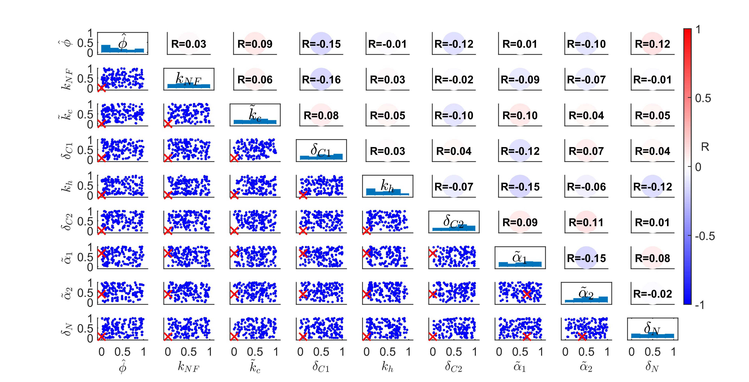
Parameter Retrieval:
Results and Discussion

Slide 21
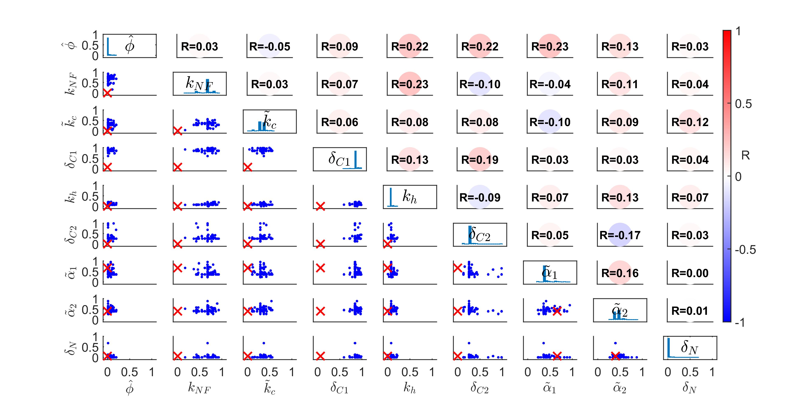
Parameter Retrieval:
Results and Discussion

Slide 22
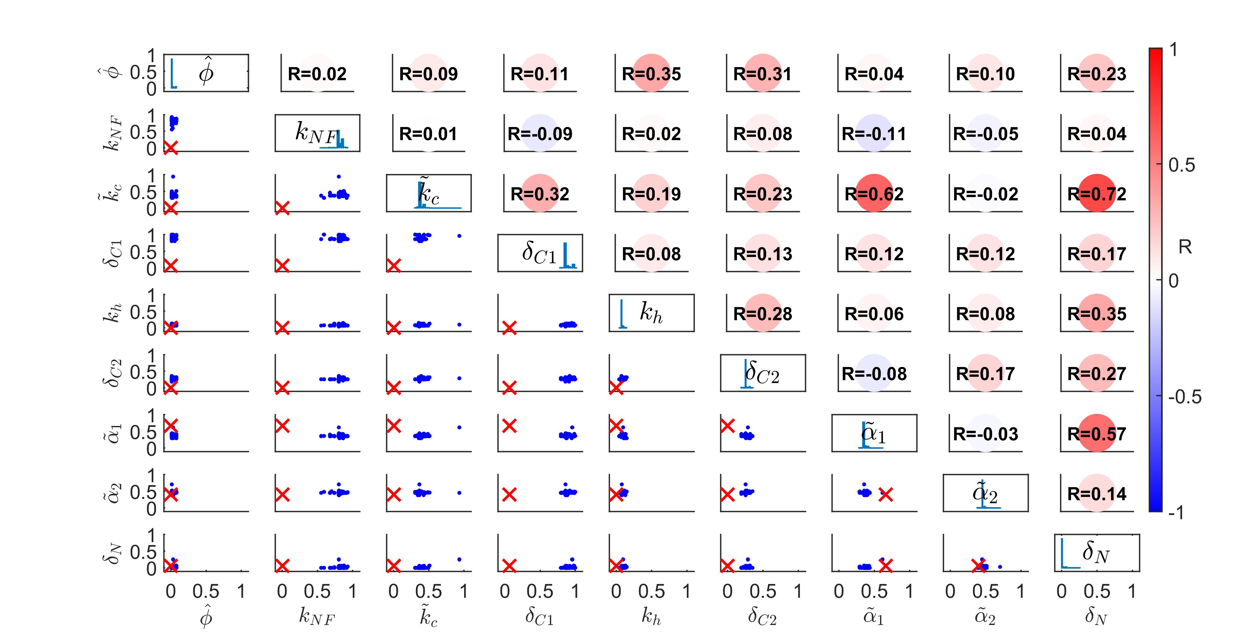
Parameter Retrieval:
Results and Discussion

Slide 23
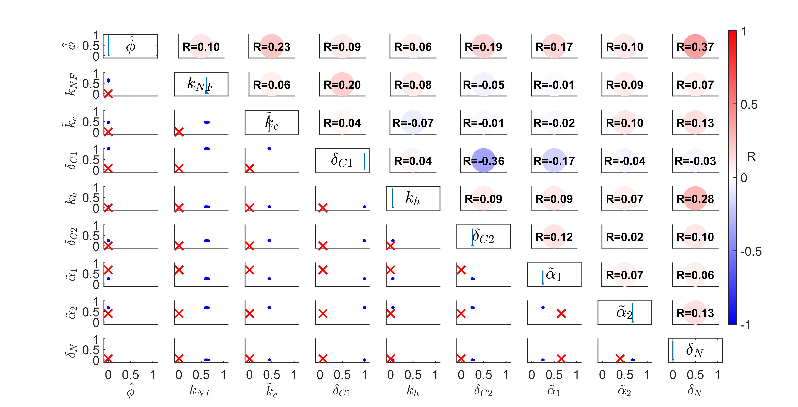
Parameter Retrieval:
Results and Discussion

Slide 24
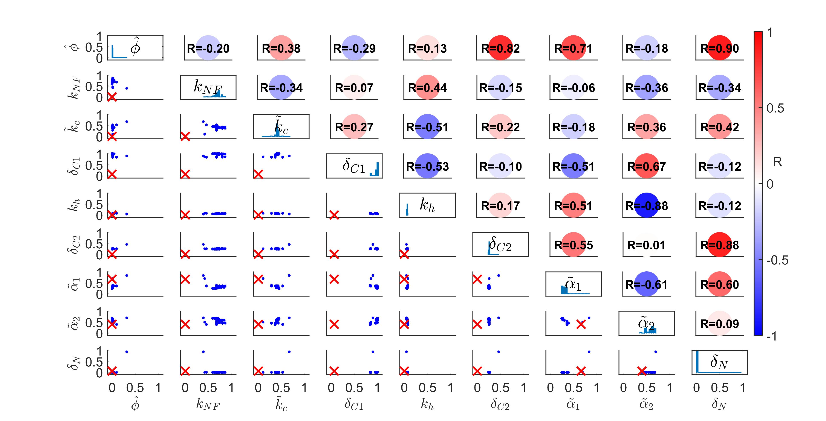
Parameter Identifiability:
Results and Discussion

Slide 25
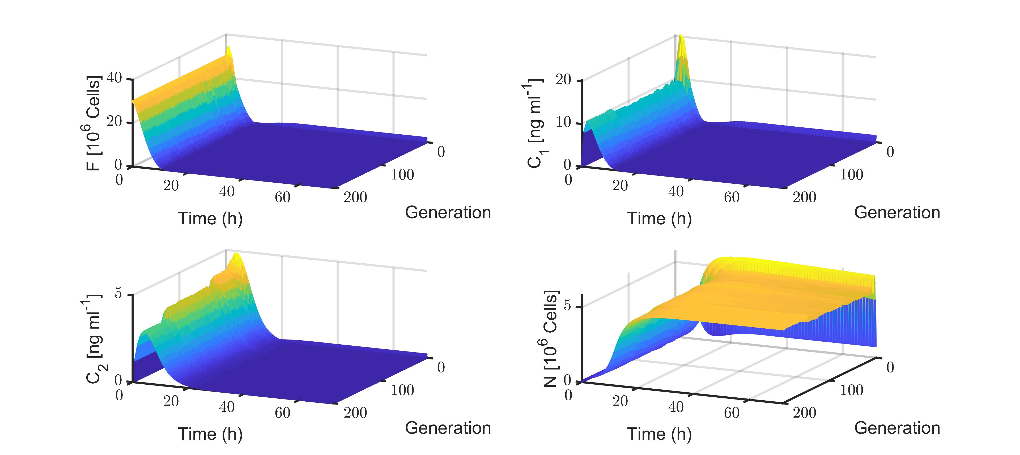
Parameter Identifiability:
Results and Discussion

Slide 26
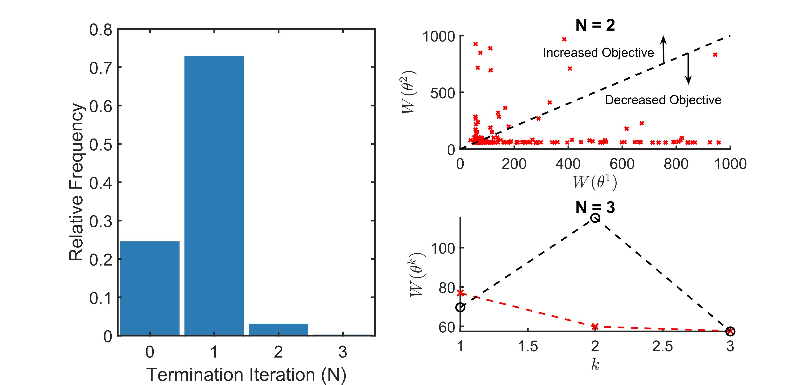
Model Stability:
Results and Discussion
Entering unsolvable region
Unavoidable

